Slide 1

Hands-On With Monte Carlo Simulations
Mohammad Soroush Barhaghi†, Younes Nejahi‡, Loren Schwiebert‡, and Jeffrey Potoff†
† Department of Chemical Engineering & Materials Science, College of Engineering,
‡ Department of Computer Science, College of Engineering, Wayne State University, Detroit, MI,
USA 48202
Notes:
1- MC simulation engine
2- Developed by potoff group & schwibert
3- Developed for running on CPU and GPU
4- CPU system size < 10,000
5- GPU system size > 10,000

Slide 2
Tutorial files
On GitHub
Git clone https://github.com/ GOMC-WSU /Workshop.git
Website https://github.com/GOMC-WSU/Workshop
To run example: copy GOMC_CPU_NVT from GOMC/bin to Workshop/NPT/SPCE/

Slide 3
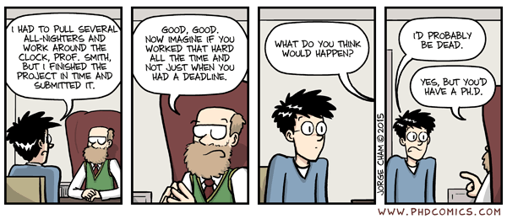
Acknowledgements
Jason Mick, Younes Nejahi, Kamel Rushaidat, Niloofar Torabi, Brock Jackman, Navendu Bhatnagar, Ganesh Kamath, Loren Schwiebert
National Science Foundation CBET-1066661, ACI-1148168, ACI-1642406
NVIDIA, Silicon Mechanics
Grid Computing at WSU

Slide 4
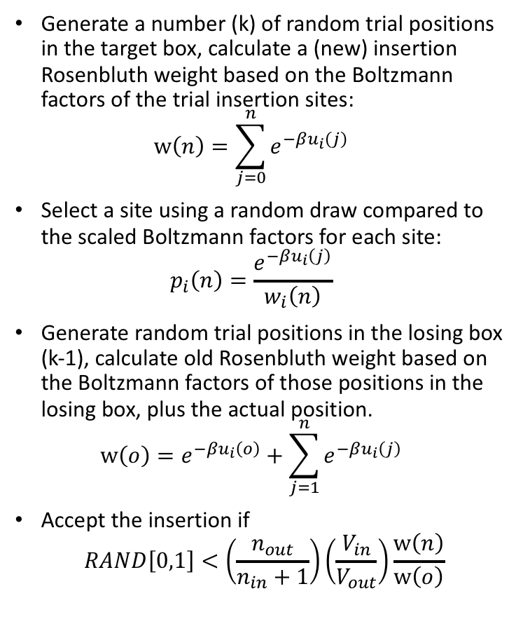
Configurational-Bias Monte Carlo
Generate a number (k) of random trial positions in the target box, calculate a (new) insertion Rosenbluth weight based on the Boltzmann factors of the trial insertion sites: $w\left(n\right)=\sum_{j=0}^{n}{e^{−βu_{i}\left(j\right)}}$
Select a site using a random draw compared to the scaled Boltzmann factors for each site: $p_{i}\left(n\right)=\frac{e^{−βu_{i}\left(j\right)}}{w_{i}\left(n\right)}$
Generate random trial positions in the losing box (k-1), calculate old Rosenbluth weight based on the Boltzmann factors of those positions in the losing box, plus the actual position. $w\left(o\right)=e^{−βu_{i}\left(o\right)}+\sum_{j=1}^{n}{e^{−βu_{i}\left(j\right)}}$
Accept the insertion if
$$RAND\left[0,1\right]<\left(\frac{n_{out}}{n_{in}+1}\right)\left(\frac{V_{in}}{V_{out}}\right)\frac{w\left(n\right)}{w\left(o\right)}$$
Trial insertion
Existing molecules

Slide 5
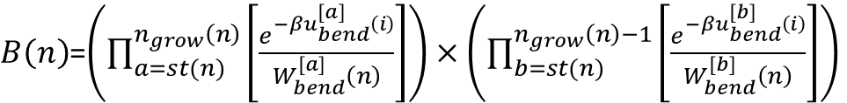
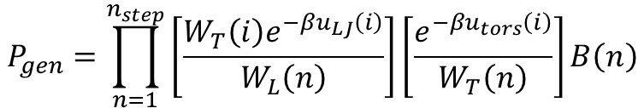
Coupled-Decoupled Configurational Bias
For n sites grown off a branch point n_{grow}(n)=n-1
$B\left(n\right)$=$\left(\prod_{a=st(n)}^{n_{grow}\left(n\right)}{\left[\frac{e^{−βu_{bend}^{[a]}\left(i\right)}}{W_{bend}^{[a]}\left(n\right)}\right]}\right)×\left(\prod_{b=st(n)}^{n_{grow}\left(n\right)−1}{\left[\frac{e^{−βu_{bend}^{[b]}\left(i\right)}}{W_{bend}^{[b]}\left(n\right)}\right]}\right)$
# of growth steps
where each step regrows all segments from a branch point
These angles ([b]) are spatially dependent on the picks from [a].
These angles ([a]) are fully independent from a spatial perspective
Torsion is coupled to nonbonded energy
i₁
a₁
t
$$P_{gen}=\prod_{n=1}^{n_{step}}{\left[\frac{W_{T}\left(i\right)e^{−βu_{LJ}\left(i\right)}}{W_{L}\left(n\right)}\right]\left[\frac{e^{−βu_{tors}\left(i\right)}}{W_{T}\left(n\right)}\right]B\left(n\right)}$$
p
b₁
f
i₂
a₂
i₃
Picking for bond angle is decoupled.
Martin and Siepmann, J. Phys. Chem B, 103, 4508 (1999)

Slide 6

Introduction to GOMC

Slide 7
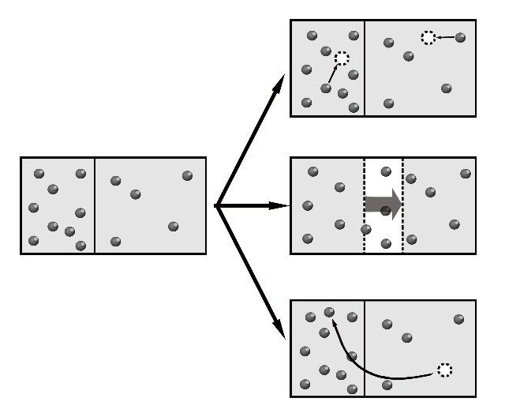
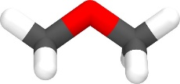
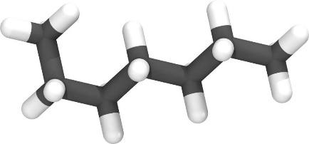

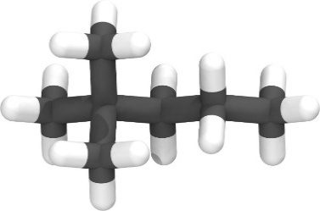
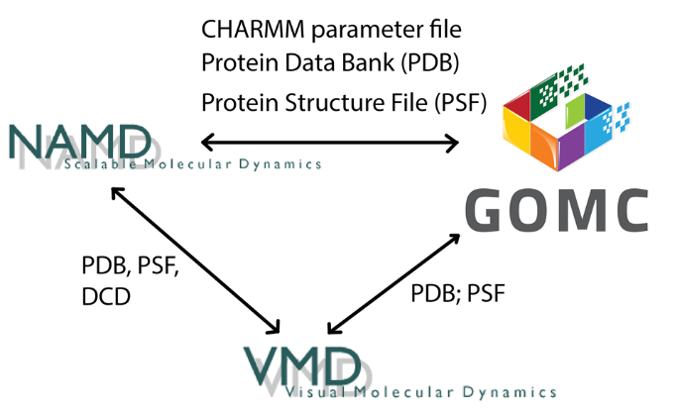
NVT, NPT,
GCMC, and GEMC
Linear, Branched,
Polar
Martini
Charmm
OPLS
Mie
Custom Potential
Moves Supported:
Displacement
Rotation
Swap (CD-CBMC)
Intra-Swap (CD-CBMC)
Regrowth (CD-CBMC)
MEMC
Intra-MEMC
CrankShaft
Volume:
Const. Ratio
Const. Area
Parallelization
CPU
OpenMP
GPU
OpenMP + GPU

Slide 8
GOMC I/O
PDB
PDB
PSF
PSF
Log
Parameter
Block Averages
Control
GCMC: Histogram

Slide 9
GOMC I/O: Input
PDB
Coordinates of all atoms
PSF
Connectivity between atoms and partial charges.
Maps atom names to atom types
Parameter
Bonded and non-bonded parameters for all atoms,
bonds, angles and dihedrals
Control
Simulation run conditions: box size, temperature
Move ratios, parameter files, etc.

Slide 10
NPT Monte Carlo Example
Create Topology and Parameter files.
Build PDB and PSF files.
Equilibrate the SPC/E water at 300 K using NVT ensemble.
Simulation of SPC/E water at 300 K and 1.0 bar, using equilibrated system.
Use the example files to run simulation to calculate the average energy and radial distribution function.

Slide 11
Building new molecules
Need atomic coordinates of the molecule of interest in PDB format (provided).
Entry in topology file defining bonds between atoms, map of atom names to atom types, and partial charges.
PDB
Topology
PDB-all, PSF
Packmol
PSFGEN

Slide 12
Single PDB file
X, Y, Z coordinates
ATOM 1 H1 SPCE 1 4.665 10.828 11.349 0.00 0.00
ATOM 2 O1 SPCE 1 4.365 11.775 11.228 0.00 0.00
ATOM 3 H2 SPCE 1 4.473 12.272 12.089 0.00 0.00
END
Atom ID
Atom name
Occupancy
residue name
Residue ID
Beta

Slide 13
Topology file
RESI SPCE 0.00
GROUP
ATOM O1 OT -0.847600 ! O1
ATOM H1 HT 0.423800 ! / \
ATOM H2 HT 0.423800 ! H1 H2
BOND O1 H1 O1 H2
PATCHING FIRS NONE LAST NONE
Defines residue name
Maps atom name to atom type
Column 3 is the partial charge
Defines bonds between pairs of atoms.

Slide 14
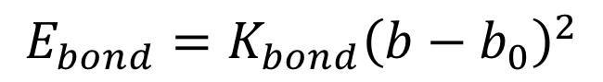
Parameter file: Bonds
EXOTIC
CHARMM
BONDS
!
!V(bond) = Kb(b - b0)**2
!
!atom type Kb(K/mole/A**2) b0 (A) description
OT HT 9999999999 1.000 ! Fixed.
BONDS
!
!V(bond) = Kb(b - b0)**2
!
!atom type Kb(Kcal/mol /A**2) b0 (A) description
OT HT 9999999999 1.000 ! Fixed.
$$E_{bond}=K_{bond}{\left(b−b_{0}\right)}^{2}$$

Slide 15
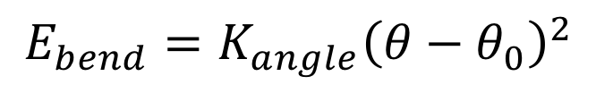
Parameter file: Angles
EXOTIC
CHARMM
ANGLES
!
!V(angle) = Ktheta(Theta - Theta0)**2!
!
!atom types Ktheta(K/mole/rad**2) Theta0(degree)
HT OT HT 9999999999 109.50 ! fixed
ANGLES
!
!V(angle) = Ktheta(Theta - Theta0)**2!
!
!atom types Ktheta(Kcal/mole/rad**2) Theta0(degree)
HT OT HT 9999999999 109.50 !fixed
$$E_{bend}=K_{angle}{\left(θ−θ_{0}\right)}^{2}$$

Slide 16
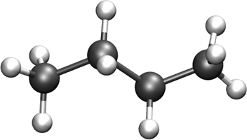
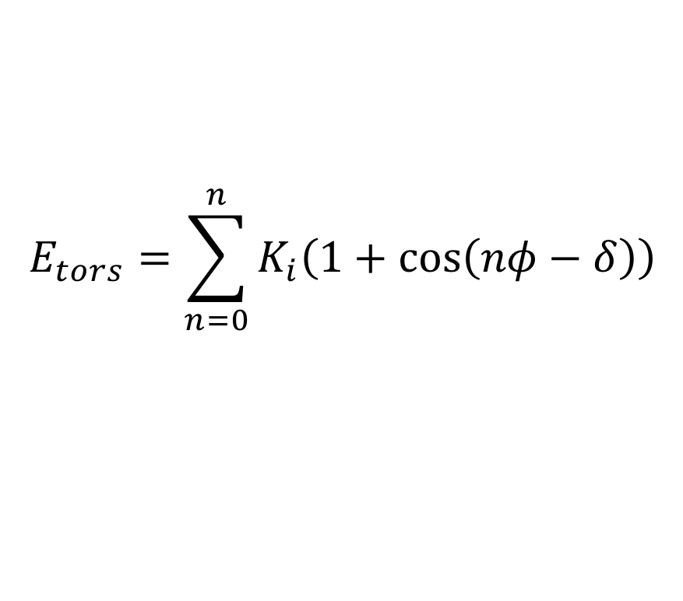
Parameter file: Dihedrals
EXOTIC
CHARMM
DIHEDRALS
!
! V(dihedral) = Kchi(1 + cos(n(chi) - delta))
!
!atom types Kchi(K/mole) n delta(degree)
X CH2 CH2 X 0.000000 0 0.0 !
X CH2 CH2 X 355.029964 1 0.0 !
X CH2 CH2 X -68.189775 2 180.0 !
X CH2 CH2 X 791.317812 3 0.0 !
DIHEDRALS
!
! V(dihedral) = Kchi(1 + cos(n(chi) - delta))
!
!atom types Kchi(Kcal/mole) n delta(degree)
X CH2 CH2 X 0.000000 0 0.0 !
X CH2 CH2 X 0.705517 1 0.0 !
X CH2 CH2 X -0.135507 2 180.0 !
X CH2 CH2 X 1.572510 3 0.0 !
$$E_{tors}=\sum_{n=0}^{n}{K_{i}\left(1+\cos\left(nφ−δ\right)\right)}$$

Slide 17
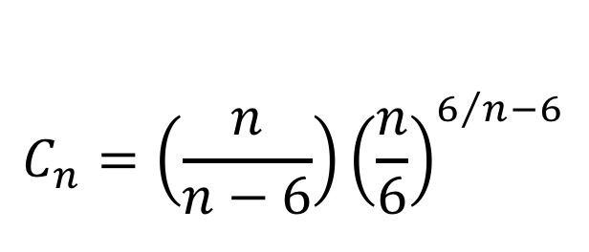
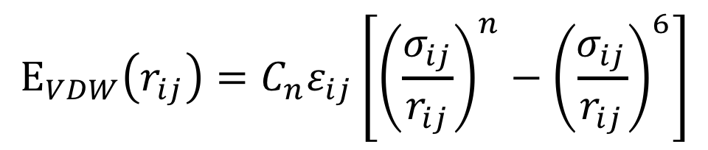
Parameter file: Nonbonded
EXOTIC
NONBONDED_MIE
!
! V(mie) = 4*eps*((sig_ij/r_ij)**n-(sig_ij/r_ij)**6)
!
!atom type eps(K) sigma(A) n eps,1-4(K) sigma,1-4(A) n,1-4 !description
CH4 78.2054 3.167 12 0.00 0.000 0 ! SPCE
HT 0.0000 0.000 12 0.00 0.000 0 ! SPCE
$$E_{VDW}\left(r_{ij}\right)=C_{n}ε_{ij}\left[{\left(\frac{σ_{ij}}{r_{ij}}\right)}^{n}−{\left(\frac{σ_{ij}}{r_{ij}}\right)}^{6}\right]$$
$$C_{n}=\left(\frac{n}{n−6}\right){\left(\frac{n}{6}\right)}^{6/n−6}$$

Slide 18
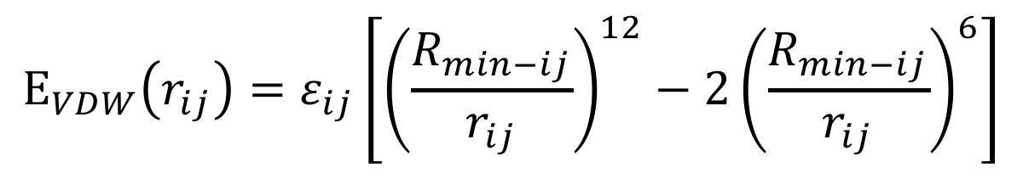
Parameter file: Nonbonded
CHARMM
NONBONDED
!
! V(LJ) = eps,i,j[(Rmin,i,j/ri,j)**12 - 2(Rmin,i,j/ri,j)**6]
!
!atom type ignored eps(Kcal/mol) Rmin/2(A) ignored eps,1-4(Kcal/mol) Rmin/2,1-4(A) !description
OT 0.0 -0.15541 1.7774185 0.0 0.00 0.00 ! SPCE
HT 0.0 0.00000 0.0000000 0.0 0.00 0.00 ! SPCE
$$E_{VDW}\left(r_{ij}\right)=ε_{ij}\left[{\left(\frac{R_{min−ij}}{r_{ij}}\right)}^{12}−2{\left(\frac{R_{min−ij}}{r_{ij}}\right)}^{6}\right]$$

Slide 19
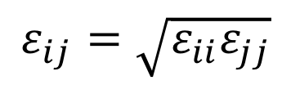
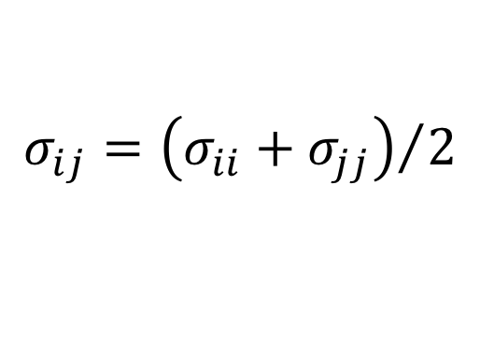
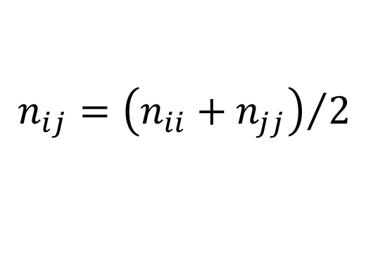
Parameter file: Nonbonded Fix (adsorbates)
EXOTIC
NBFIX_MIE
!
! V(mie) = 4*eps*((sig_ij/r_ij)**n-(sig_ij/r_ij)**6)
!
!type1 type2 eps(K) sigma(A) n eps,1-4(K) sigma,1-4(A) n,1-4 !description
C C 0.00 0.000 0 0.00 0.000 0 !
C H 0.00 0.000 0 0.00 0.000 0 !
C O 0.00 0.000 0 0.00 0.000 0 !
C ZN 0.00 0.000 0 0.00 0.000 0 !
$$σ_{ij}={\left(σ_{ii}+σ_{jj}\right)}/2$$
$$ε_{ij}=\sqrt{ε_{ii}ε_{jj}}$$
$$n_{ij}={\left(n_{ii}+n_{jj}\right)}/2$$

Slide 20
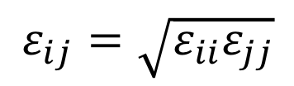
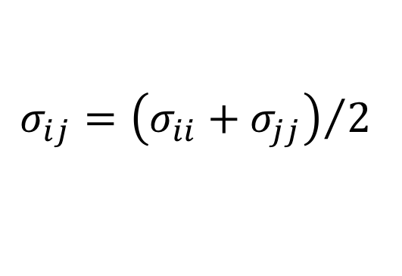
Parameter file: Nonbonded Fix (adsorbates)
CHARMM
NBFIX
!
! V(LJ) = Eps,i,j[(Rmin,i,j/ri,j)**12 - 2(Rmin,i,j/ri,j)**6]
!
! type1 type2 ignored eps(Kcal/mol) Rmin(A) ignored eps,1-4(Kcal/mol) Rmin,1-4(A) !description
C C 0.0 0.000 0.000 0.0 0.00 0.00 !
C H 0.0 0.000 0.000 0.0 0.00 0.00 !
C O 0.0 0.000 0.000 0.0 0.00 0.00 !
C ZN 0.0 0.000 0.000 0.0 0.00 0.00 !
$$σ_{ij}={\left(σ_{ii}+σ_{jj}\right)}/2$$
$$ε_{ij}=\sqrt{ε_{ii}ε_{jj}}$$
NOTE: CHARMM uses Rmin rather than Rmin/2

Slide 21
Build initial PDB configuration
300 K, 0.935 g/cm³ (liquid density); 250 molecules -> L=20.0 A
tolerance 2.7
filetype pdb
output packed_water.pdb
Structure ./singleMolecule/SPCE.pdb
number 250
inside cube 0.1 0.1 0.1 19.0
end structure
Execute this command:
./packmol <pack_box_0.inp

Slide 22
Build PSF
SPC/E Water
psfgen<<ENDMOL
topology ./top_SPCE_water.inp
segment SPCE {
pdb ./packed_water.pdb
auto angles dihedrals
first none
last none
}
Coordpdb ./packed_water.pdb SPCE
Writepsf ./START_BOX_0.psf
writepdb ./START_BOX_0.pdb
Execute this command:
vmd < ./build_psf_box_0.tcl
Notes:
Auto angles dihedrals tells psfgen to automatically generate the required angle and dihedral information.

Slide 23
Control file
eq.conf
prod.conf
Restart false
# FORCE FIELD
ParaTypeCHARMM true
Parameters ./par_SPCE_Charmm.par
# INPUT PDB
Coordinates 0 ./../build/START_BOX_0.pdb
# INPUT PSF
Structure 0 ./../build/START_BOX_0.psf
# MOVE FREQUENCY
DisFreq 0.50
RotFreq 0.40
RegrowthFreq 0.10
# BOX DIMENSION #, X, Y, Z
CellBasisVector1 0 20.00 0.00 0.00
CellBasisVector2 0 0.00 20.00 0.00
CellBasisVector3 0 0.00 0.00 20.00
Restart true
# FORCE FIELD
ParaTypeCHARMM true
Parameters ./par_SPCE_Charmm.par
# INPUT PDB
Coordinates 0 ./../Equilibration/SPCE_EQ_BOX_0_restart.pdb
# INPUT PSF
Structure 0 ./../Equilibration/SPCE_EQ_merged.psf
# MOVE FREQUENCY
DisFreq 0.50
RotFreq 0.49
VolFreq 0.01
# BOX DIMENSION #, X, Y, Z
# CellBasisVector1 0 20.00 0.00 0.00
# CellBasisVector2 0 0.00 20.00 0.00
# CellBasisVector3 0 0.00 0.00 20.00

Slide 24
GOMC I/O: LOG Output
MOVE_<box number>: move statistics
ENER_<box number>: energies
STAT_<box number>: density
Data are stored in columns, making them straightforward to extract with awk.
Quantities instantaneous values, and are defined with MTITLE, ETITLE and STITLE headers near the beginning of the log file.
Notes:
Talk about output file when Production is running!

Slide 25
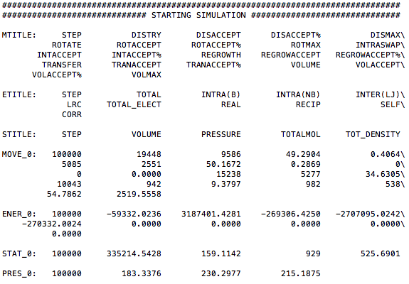
GOMC I/O: LOG Output

Slide 26
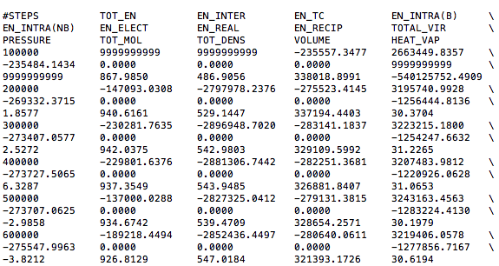
GOMC I/O: BLOCK Output

Slide 27
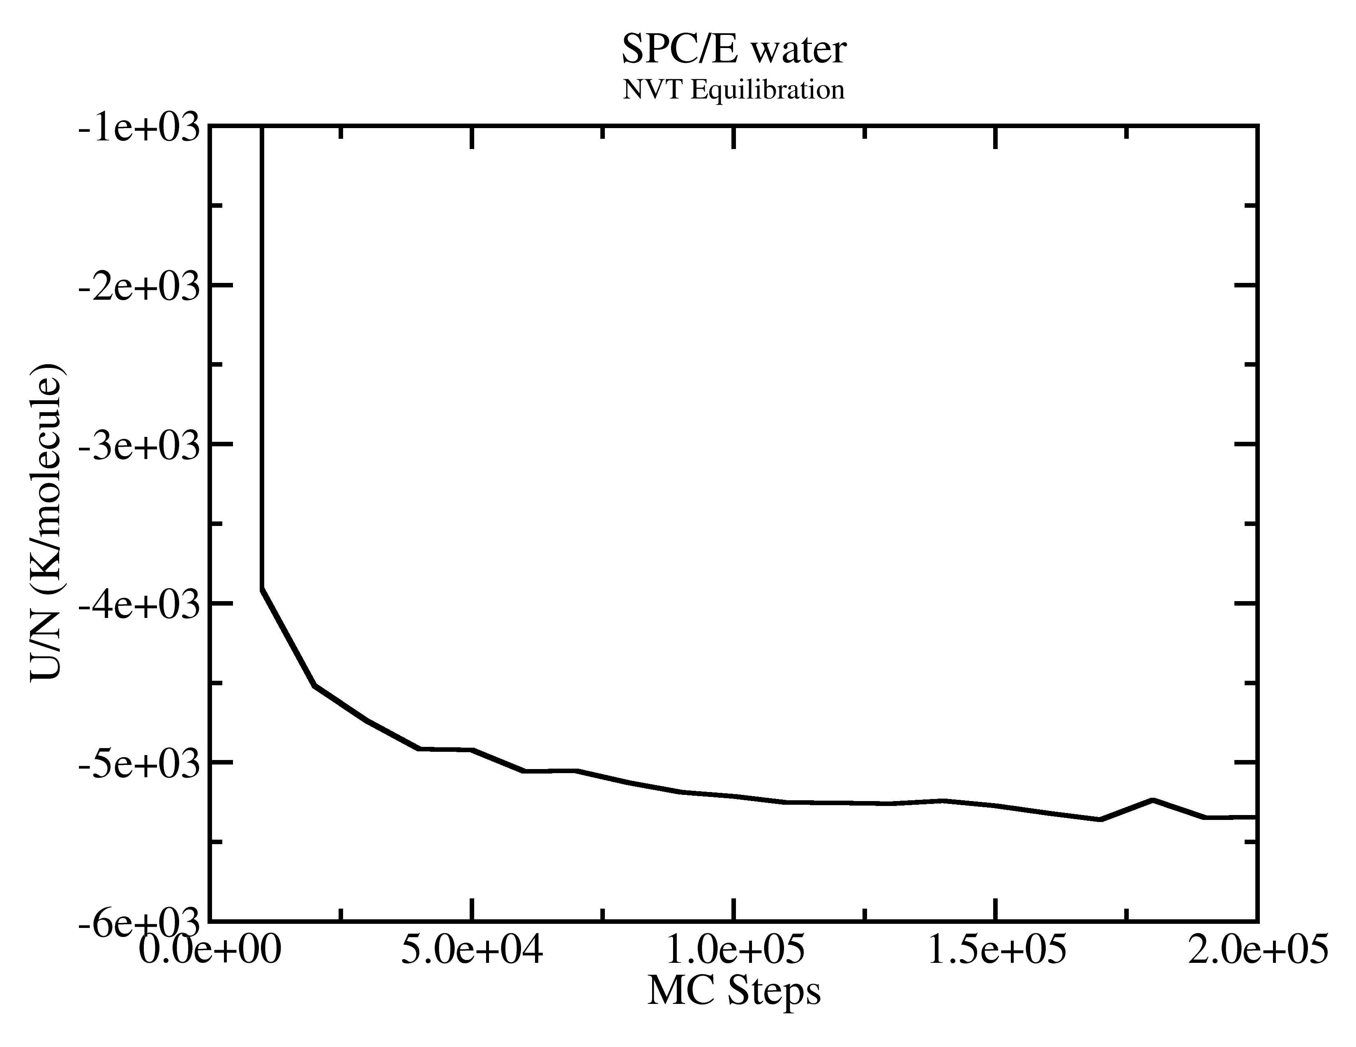
GOMC I/O: Output
Extract data using awk
awk ‘/ENER_0/ {print $2, $3}’ output_water.log > energy.dat
grep “ENER_0” output_water.log | awk ‘{print $2, $3}’ > energy.dat

Slide 28
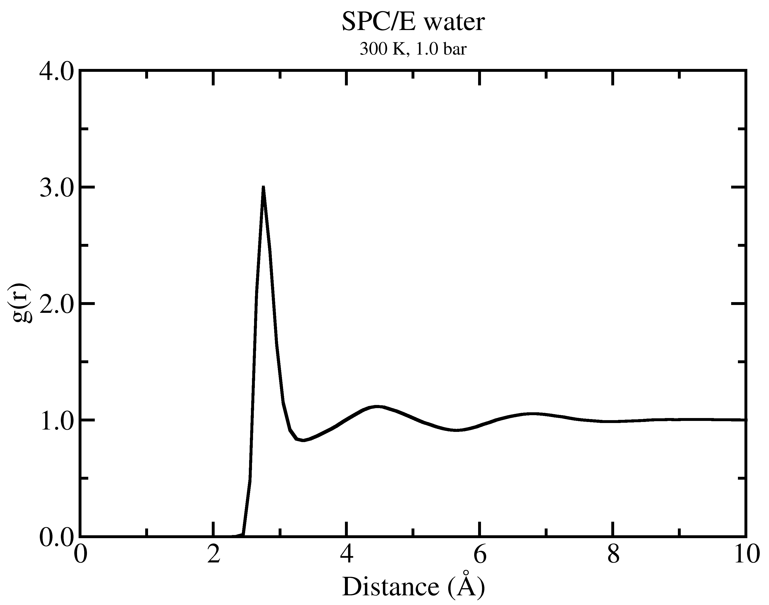
GOMC: RDF
OT - OT
Follow README.txt to generate RDF

Slide 29

Gibbs Ensemble Monte Carlo
Particle Displacement
Volume Exchange
Bulk liquid and vapor
External (NVT): N_{T}, V_{T}, T are constant Chemical equilibrium: μ_{L}= μ_{V}
Mechanical Equilibrium: P_{V}=P_{L}
Molecule Transfer

Slide 30
GEMC Example
Workshop/NVT_GEMC
Need to build initial configurations for two boxes.
Issuing the following commands to create START_BOX_*.pdb, *.psf
./packmol <pack_box_0.inp
./packmol <pack_box_1.inp
./build_psf_box_0.tcl or try vmd < build_psf_box_0.tcl
./build_psf_box_1.tcl or try vmd < build_psf_box_1.tcl
Could be combined into a single shell script.

Slide 31
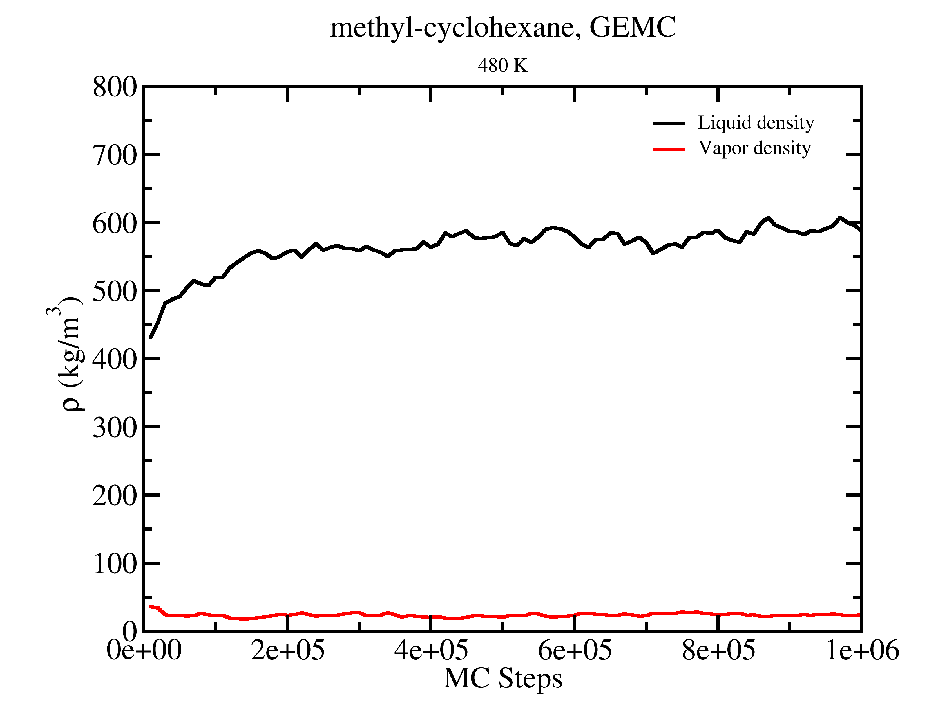
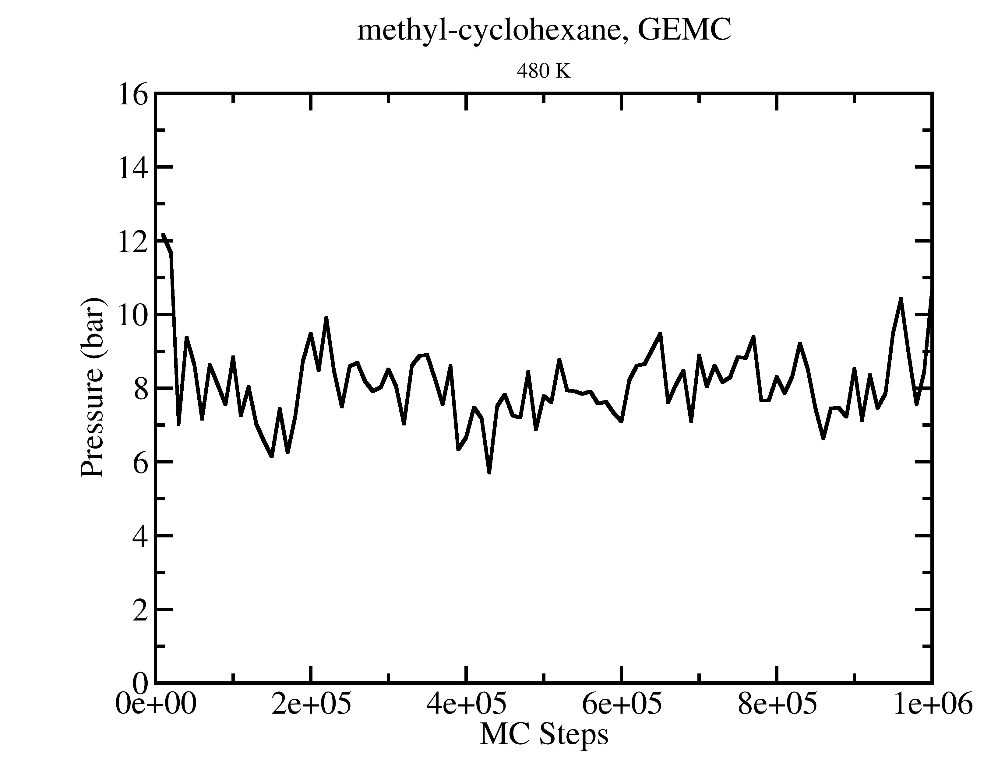
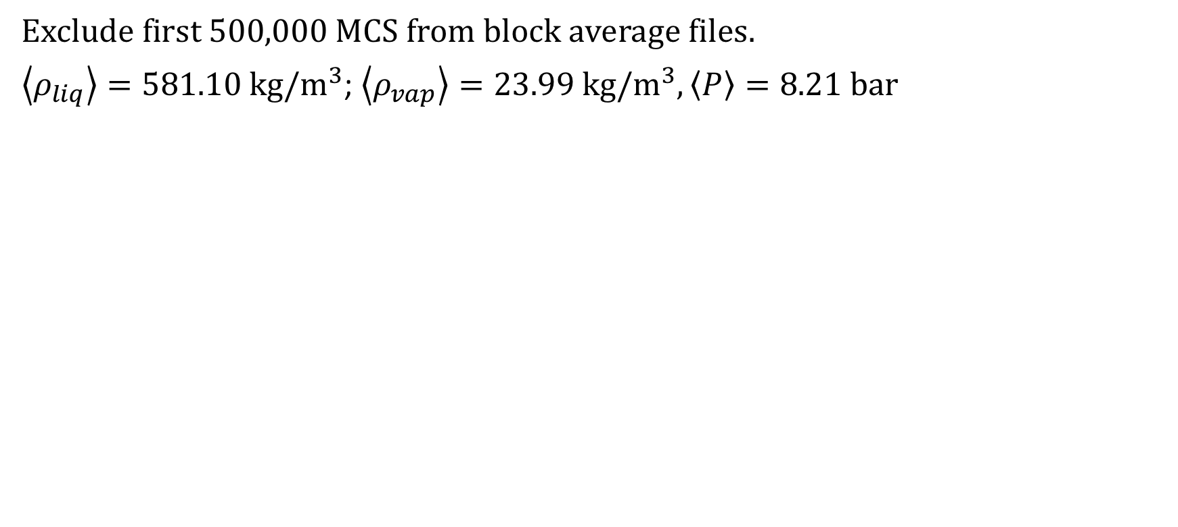
GEMC: methyl-cyclohexane 480 K
Exclude first 500,000 MCS from block average files.
$\left\langle ρ_{liq}\right\rangle =581.10 kg/m^{3}$; $\left\langle ρ_{vap}\right\rangle =23.99 kg/m^{3}, \left\langle P\right\rangle =8.21 bar$

Slide 32
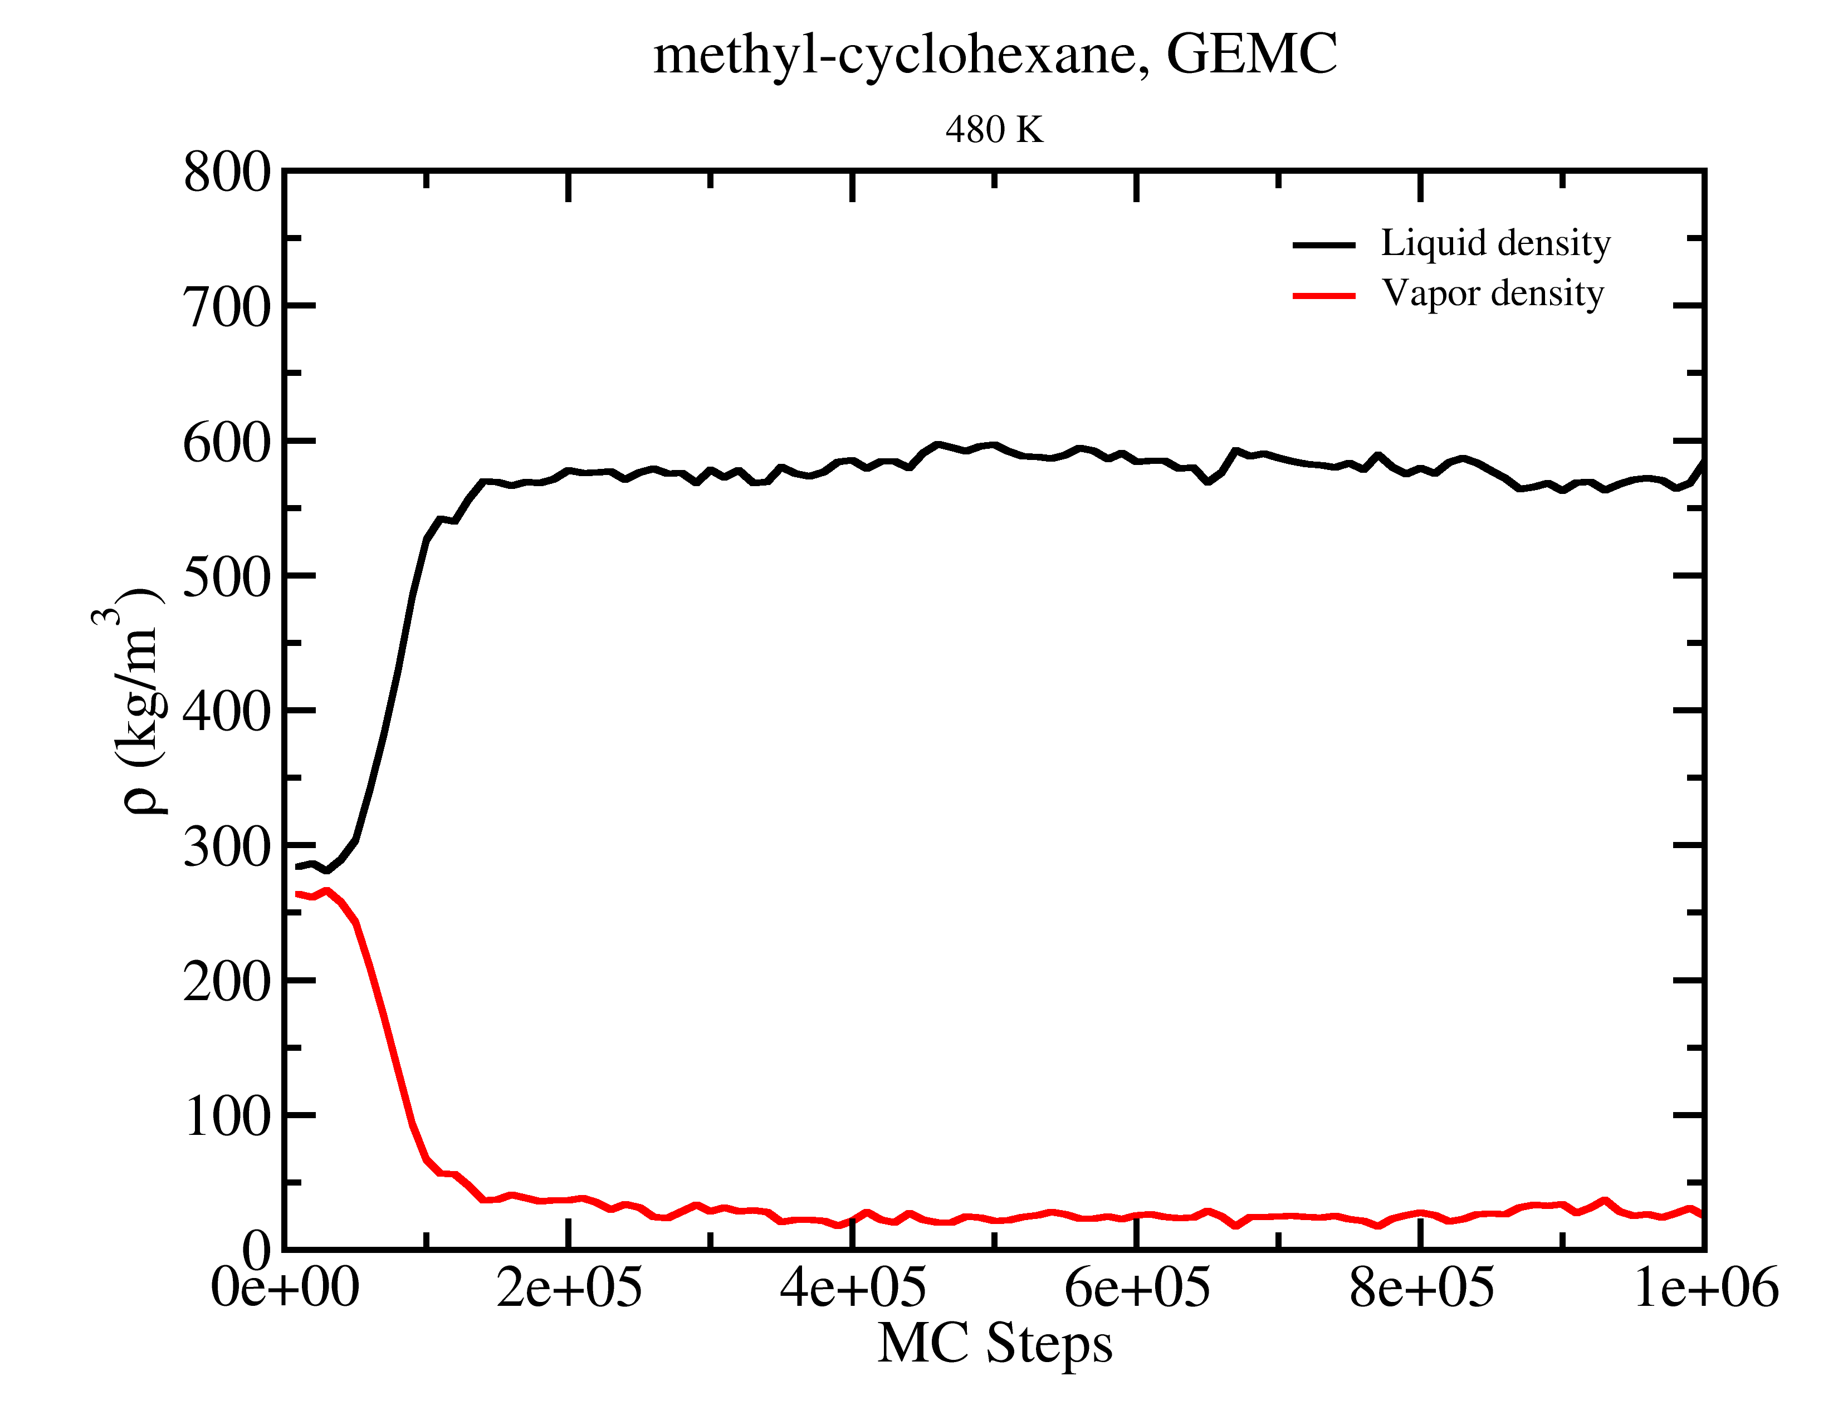
GEMC: methyl-cyclohexane 480 K
Start from 250 molecules and L=53 A
for each box.
As long as one starts in the two phase region, GEMC will form two distinct phases.
Gas
Gas
Liquid
Liquid

Slide 33
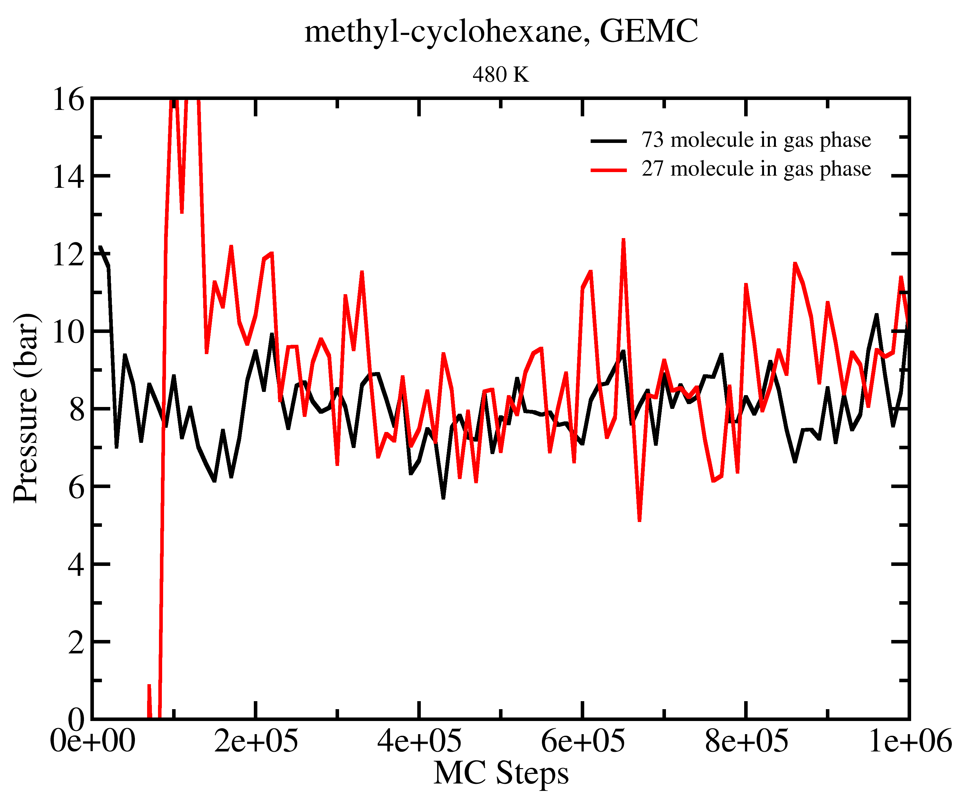
GEMC Tips
Choice of simulation parameters may effect length of equilibration required.
Number of molecules in each phase also effects the magnitude of the statistical uncertainties.

Slide 34
GEMC PDB Output
PDB output files for each box contain coordinates for all molecules in the simulation: mC6cycle_GEMC_T_480K_BOX_0.pdb
The occupancy column is used to designate the box to which each molecule belongs. “imaginary” molecules are given coordinates of 0,0,0.
ATOM 76 C6 1C6 A 11 33.658 11.434 28.090 0.00 0.00
ATOM 77 C7 1C6 A 11 36.151 10.979 27.972 0.00 0.00
ATOM 78 C1 1C6 A 12 0.000 0.000 0.000 1.00 0.00
Unfortunately, VMD does not understand changing the number of molecules in the simulation. VMD also does not update occupancy values.

Slide 35
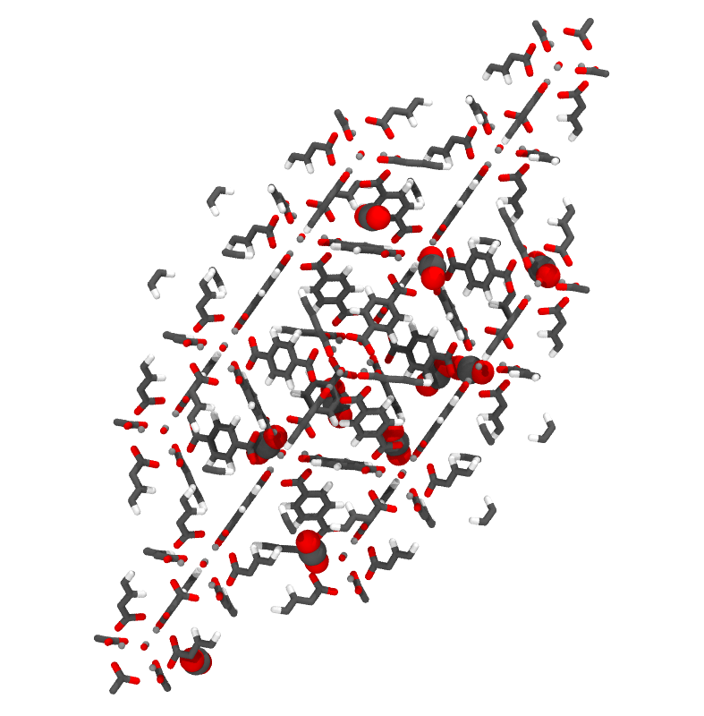
Grand Canonical Monte Carlo Example

Slide 36
Grand Canonical Monte Carlo Example
Create Topology file for adsorbate.
Build PDB and PSF files for adsorbate.
Simulation of CO₂ adsorption in IRMOF-1 at 298 K and 1.0 bar.
Calculate the number of CO₂ adsorbed.

Slide 37
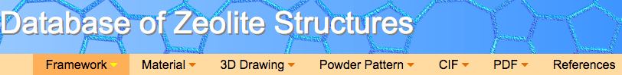

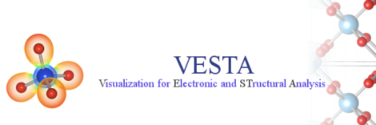
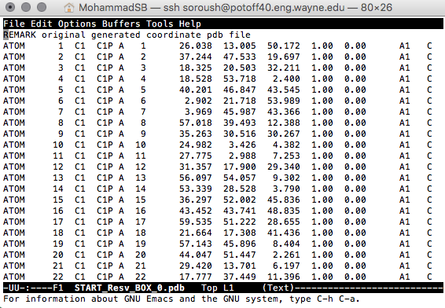
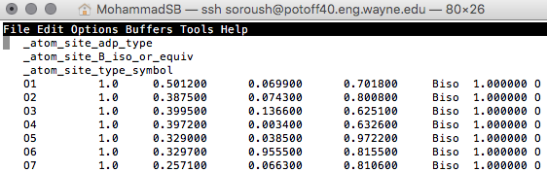
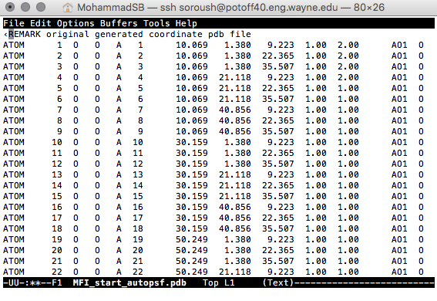
Creating PDB for adsorbent:
Beta = 0: Displace, Rotate, Intra-swap, Swap, regrowth
Beta = 1: Fix
Beta = 2: Displace, Rotate, Intra-swap, regrowth
Beta Value
Tcl script in VMD
Notes:
Code uses the PDB values in the PDB to determine if a particular molecule should be moved or not.

Slide 38
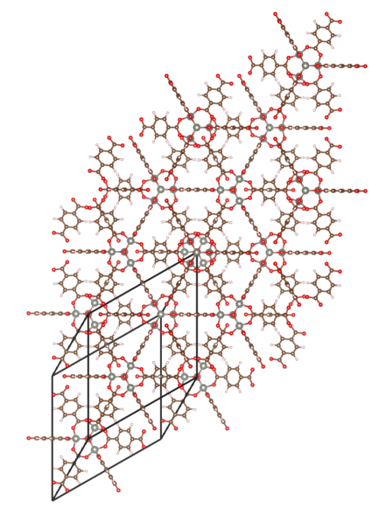
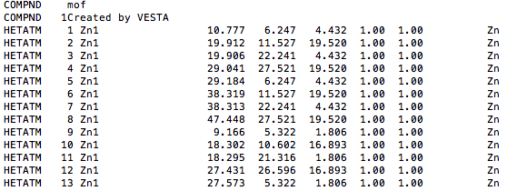
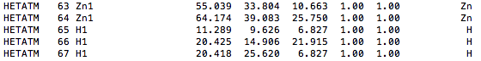
Creating PDB for adsorbent:
To generate the PDB file, each atom will be considered its own molecule. Assign resname using atom name.
Download the crystal structure.
Use VESTA to:
Extend the unit cell by factor of 2.
Remove the bonds.
Export the structure as PDB file.
: : : : : : : :

Slide 39

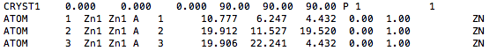
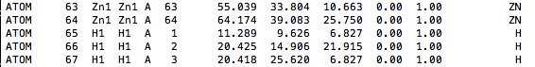
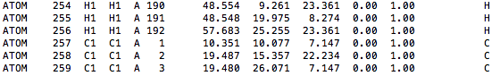
Creating PDB for adsorbent:
To generate the PDB file, each atom will be considered its own molecule. Assign resname using atom name.
Use convert script to assign resname and resid based on atom name.
vmd < ./ convert_VESTA_PDB.tcl
: : : : : : : : : : : :
: : : : : : : : : : : :

Slide 40
IRMOF-1 Topology file:
MASS 1 O 15.999 O
MASS 2 C 12.010 C
MASS 3 H 1.0079 H
MASS 4 ZN 65.3800 ZN
DEFA FIRS none LAST none
AUTOGENERATE ANGLES DIHEDRALS
RESI ZN1 1.333 ! IRMOF-1 - DFT charges
ATOM ZN1 ZN 1.333 !
PATCHING FIRS NONE LAST NONE
RESI H1 0.162 ! IRMOF-1 - DFT charges
ATOM H1 H 0.162 !
PATCHING FIRS NONE LAST NONE
RESI O1 -1.564 ! IRMOF-1 - DFT charges
ATOM O1 O -1.564 !
PATCHING FIRS NONE LAST NONE
RESI O2 -0.641 ! IRMOF-1 - DFT charges
ATOM O2 O -0.641 !
PATCHING FIRS NONE LAST NONE
RESI C1 -0.167 ! IRMOF-1 - DFT charges
ATOM C1 C -0.167 !
PATCHING FIRS NONE LAST NONE
RESI C2 0.558 ! IRMOF-1 - DFT charges
ATOM C2 C 0.558 !
PATCHING FIRS NONE LAST NONE
RESI C3 0.106 ! IRMOF-1 - DFT charges
ATOM C3 C 0.106 !
PATCHING FIRS NONE LAST NONE END

Slide 41
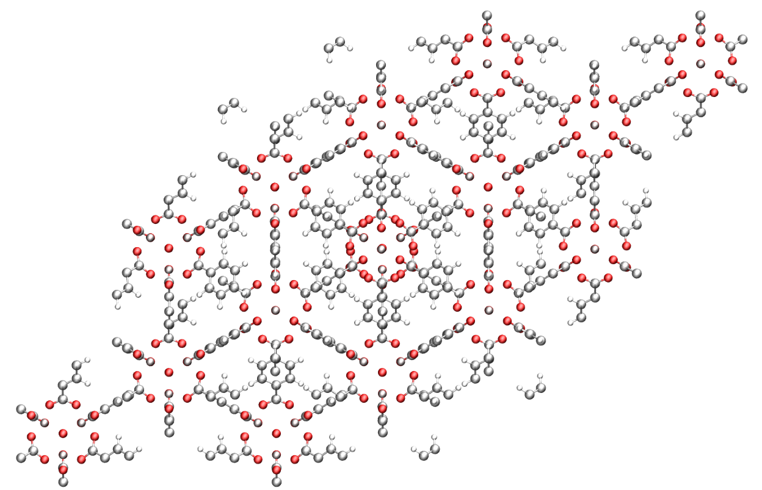
Creating PSF for adsorbent:
To generate the PSF file, separate each residue in each file and use psfgen to generate PSF file.
Use build scripts (build_EDUSIF_auto.tcl) to separate each residue type and generate PDB and PSF files.
Set beta value to 1 in PDB by using (setBeta.tcl) script.
Execute these commands:
vmd < ./build_EDUSIF_auto.tcl
vmd < ./setBeta.tcl

Slide 42
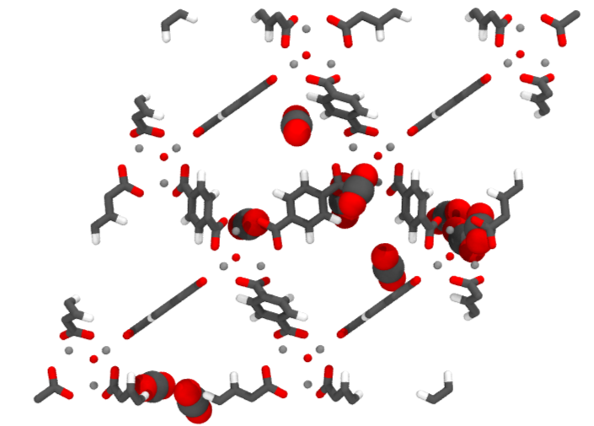
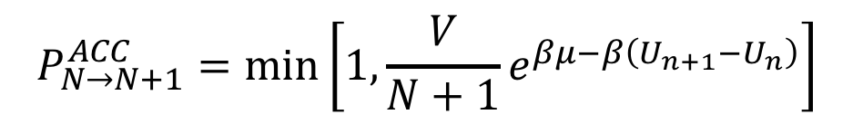
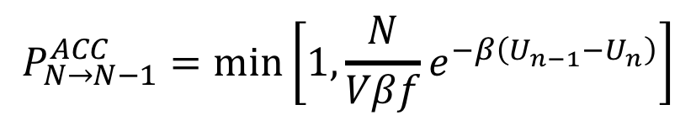
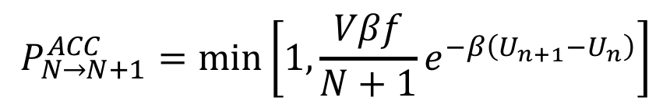
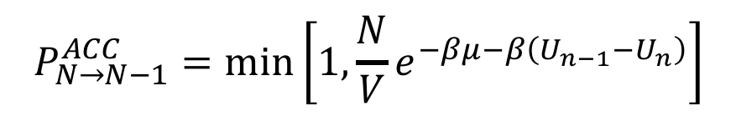
Grand Canonical Monte Carlo
Acceptance criteria for molecule swap in Grand Canonical ensemble Monte Carlo (GCMC).
Chemical Potential (K)
$$P_{N→N+1}^{ACC}=\min\left[1, {\frac{V}{N+1}e}^{βμ−β\left(U_{n+1}−U_{n}\right)}\right]$$
$$P_{N→N−1}^{ACC}=\min\left[1, {\frac{N}{V}e}^{−βμ−β\left(U_{n−1}−U_{n}\right)}\right]$$
Fugacity (bar)
$$P_{N→N+1}^{ACC}=\min\left[1, {\frac{Vβf}{N+1}e}^{−β\left(U_{n+1}−U_{n}\right)}\right]$$
$$P_{N→N−1}^{ACC}=\min\left[1, {\frac{N}{Vβf}e}^{−β\left(U_{n−1}−U_{n}\right)}\right]$$

Slide 43
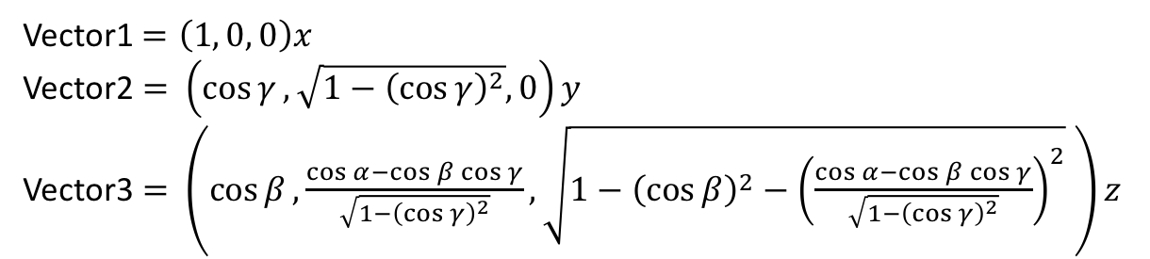
Control file: GCMC
# INPUT PDB, PSF FILES
Coordinates 0 ../build/base/IRMOF_1_BOX_0.pdb
Coordinates 1 ../build/reservoir/START_BOX_1.pdb
Structure 0 ../build/base/IRMOF_1_BOX_0.psf
Structure 1 ../build/reservoir/START_BOX_1.psf
# MOVE FREQUENCY
DisFreq 0.30
RotFreq 0.30
SwapFreq 0.40
# Chemical Potential/Fugacity
Fugacity CO2 1.0
Fugacity C1 0.0
Fugacity C2 0.0
Fugacity C3 0.0
Fugacity H1 0.0
Fugacity O1 0.0
Fugacity O2 0.0
Fugacity ZN1 0.0
# BOX DIMENSION #, X, Y, Z
CellBasisVector1 0 36.8140 0.0 0.0
CellBasisVector2 0 18.2583 31.9880 0.0
CellBasisVector3 0 18.2712 10.5596 30.1748
CellBasisVector1 1 50.00 0.00 0.00
CellBasisVector2 1 0.00 50.00 0.00
CellBasisVector3 1 0.00 00.00 50.00
# OutHistSettings
DistName dis
HistName his
RunNumber 1
RunLetter a
SampleFreq 200
Vector1$=\left(1, 0, 0\right)x$
Vector2 $=$ $\left(\cos{γ}, \sqrt{1−{\left(\cos{γ}\right)}^{2}}, 0\right)y$
Vector3 $=$ $\left(\cos{β}, \frac{\cos{α}−\cos{β\cos{γ}}}{\sqrt{1−{\left(\cos{γ}\right)}^{2}}},\sqrt{1−{\left(\cos{β}\right)}^{2}−{\left(\frac{\cos{α}−\cos{β\cos{γ}}}{\sqrt{1−{\left(\cos{γ}\right)}^{2}}}\right)}^{2}} \right)z$

Slide 44
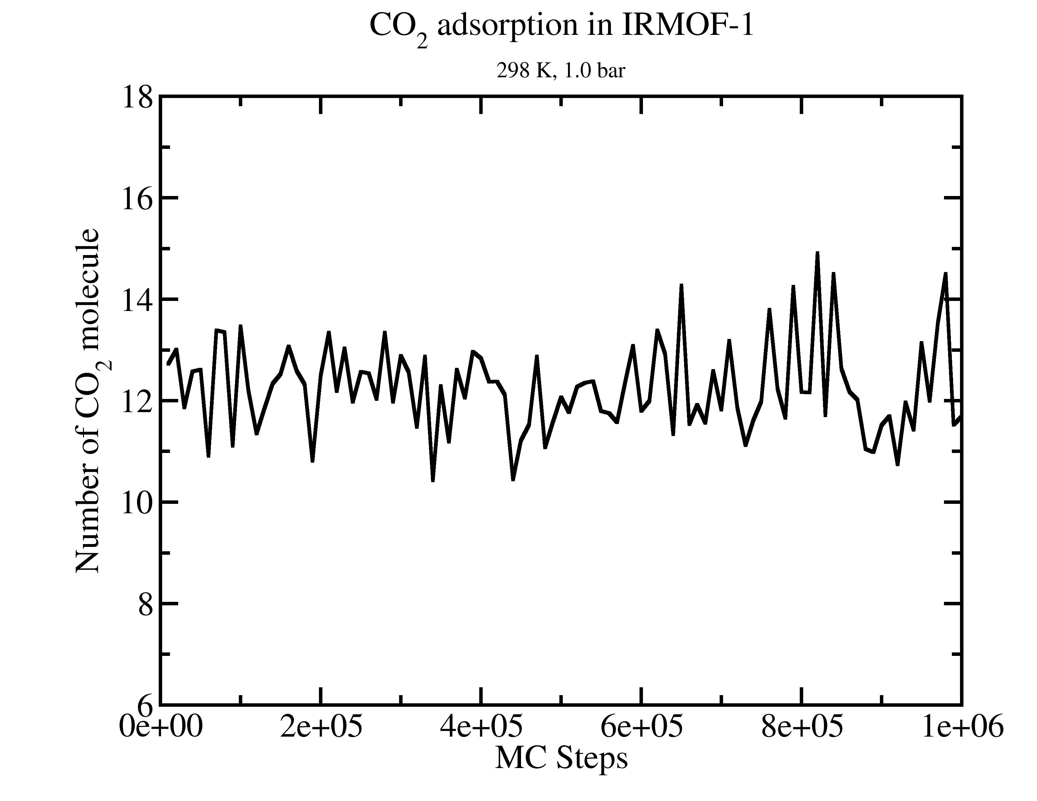

GOMC I/O: GCMC
Extract data using awk
cat Blk_CO2_IRMOF_1_BOX_0.dat | awk '{print $1, $10 * $19}' > mol_CO2.dat

Slide 45

GOMC on Multicore and GPU

Slide 46
Acknowledgements
Jason Mick, Younes Nejahi, Kamel Rushaidat, Niloofar Torabi, Brock Jackman, Navendu Bhatnagar, Ganesh Kamath, Loren Schwiebert
National Science Foundation CBET-1066661, ACI-1148168, ACI-1642406
NVIDIA, Silicon Mechanics
Grid Computing at WSU

